Slide 1
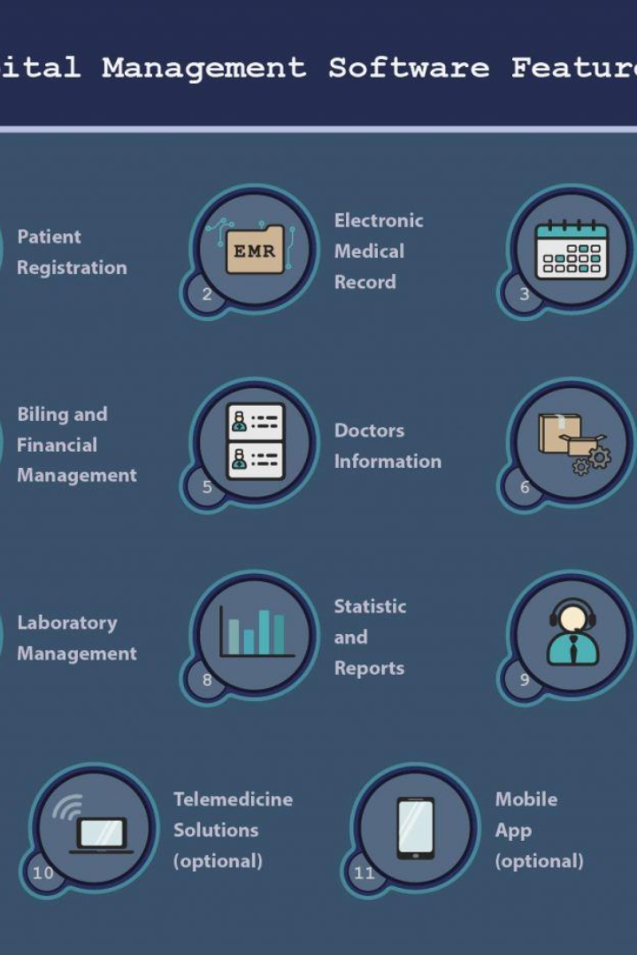
Hospital Management System
Revolutionize the way hospitals operate with our comprehensive web-based solution. Streamline patient onboarding, appointment booking, lab test reports, and more.
By Team Clover.

Slide 2

Tech Stack
We leverage cutting-edge technologies to power our Hospital Management System. Our solution is built with a robust stack that includes HTML,CSS and Java Script React.js for a seamless user interface, Node.js for efficient server-side processing, and MongoDB for scalable data storage.

Slide 3
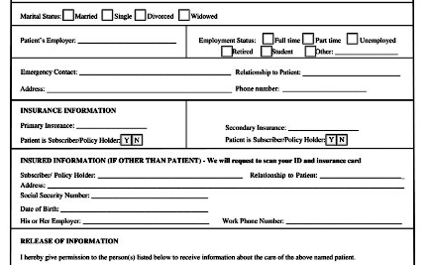


Patients Onboarding
Simple Registration Process
Facilitate Doctor-Patient Interactions
Digitize Medical Records
Eliminate paper-based records and securely store patient medical information online. Easy retrieval and reduced administrative burden.
Effortlessly onboard patients with a user-friendly registration form. Collect essential information to ensure accurate healthcare records.
Enable doctors to access patient histories, monitor progress, and provide personalized care. Enhance the doctor-patient relationship.

Slide 4

Diagnosis & Lab Test Reports
1
Automated Reporting
Receive real-time updates on lab test results. Seamlessly integrate laboratory systems for efficient and accurate reporting.
Status Dashboard
2
Monitor the status of diagnosis and lab tests at a glance with an intuitive dashboard. Easily identify pending or completed reports.
3
Collaborative Communication
Enable timely communication between doctors, patients, and lab technicians. Address concerns and discuss reports securely.

Slide 5

Queries Chatbot
24/7 Assistance
Intelligent Triage
Instantly address patient queries and provide personalized responses with our AI-powered chatbot. Improve patient satisfaction and reduce wait times.
Efficiently categorize queries and route patients to the appropriate department or specialist. Prioritize urgent cases and optimize resource allocation.
Continual Learning
Leverage machine learning to train the chatbot on common queries. Enhance accuracy and improve response times over time.

Slide 6
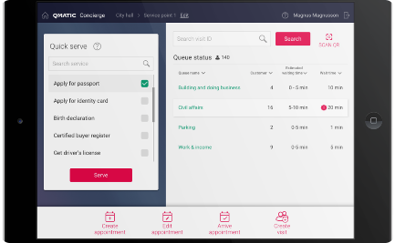


Appointment Booking
Seamless Online Booking
Real-Time Availability
Automated Reminders
Allow patients to conveniently schedule appointments online. Reduce phone call volume and enhance accessibility for all patients.
Provide patients with up-to-date information on doctor availability. Minimize appointment conflicts and maximize operational efficiency.
Send reminders for upcoming appointments via SMS or email. Reduce no-show rates and optimize appointment utilization.

Slide 7
Reminders
1
Medication Reminders
2
Follow-Up Appointments
3
Preventive Care
Promote preventive care by reminding patients about routine health screenings and immunizations. Prioritize their long-term well-being.
Help patients adhere to their medication schedules with automated reminders. Improve treatment outcomes and patient well-being.
Ensure patients attend necessary follow-up appointments by sending timely reminders. Enhance continuity of care and disease management.

Slide 8
Insurance Suggestions
Maximize Insurance Coverage
Evaluate Policy Benefits
Proactive Alerts
Alert patients about approaching insurance renewals and necessary documentation. Avoid coverage gaps and ensure uninterrupted care.
Guide patients in choosing the best insurance plans that align with their healthcare needs. Optimize cost savings and accessibility.
Help patients understand complex insurance policies and their coverage. Simplify decision-making for enhanced healthcare planning.

Slide 9
Web Stack for Healthcare Management System
Front-end
React.js
Back-end
Node.js
Database
MongoDB
Cloud Hosting
AWS

Slide 10

Implementation Details
As beginner web developers, we would utilize React.js for the front-end to build a dynamic user interface. The back-end would be powered by Node.js, ensuring efficient data transactions and seamless integration with the front-end. MongoDB would be employed as the database, offering flexibility and scalability. Leveraging AWS, we can ensure reliable cloud hosting for our healthcare management system.

